Slide 1

CA02
PRESENTATION
Advance programming techniques
LECTURER :- PAUL LAIRD
Presented By
Aravinth Joshua santhi
Paramjeet Singh
Victor Obi Okeke

Slide 2
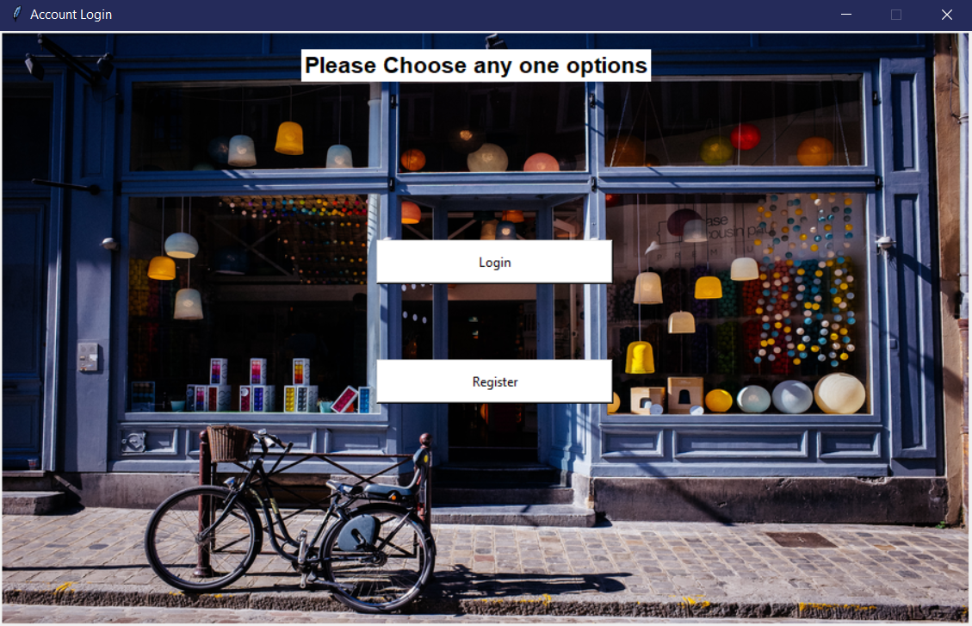
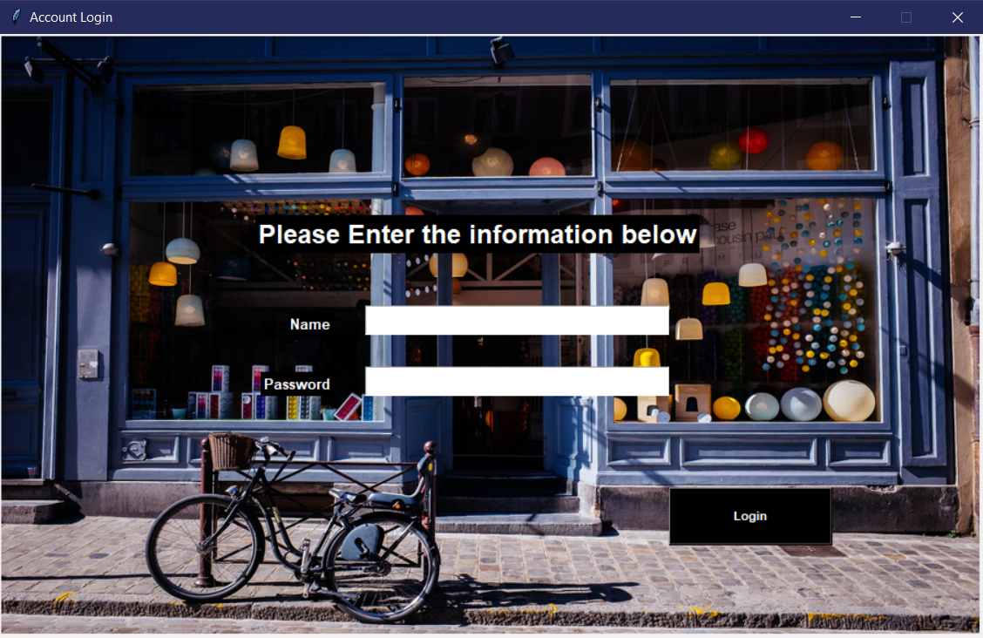
Upon initializing the main.py file the user can see two options one is to login
and one is to register
Once registered the user is able to use his credentials to login to the site

Slide 3
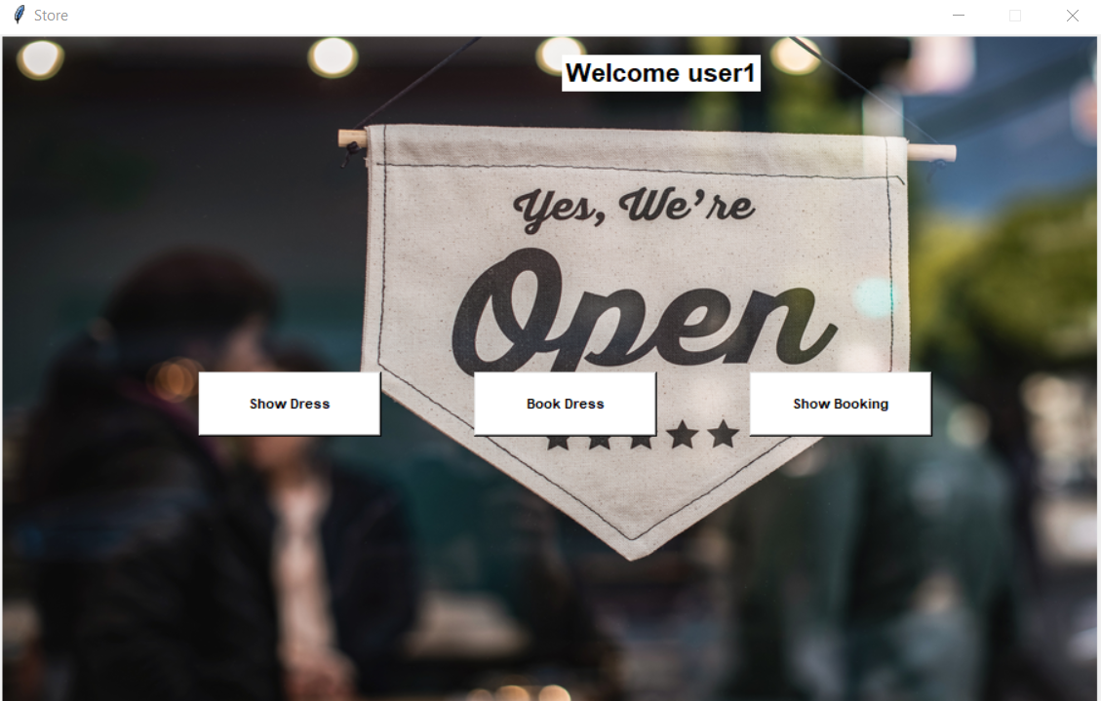
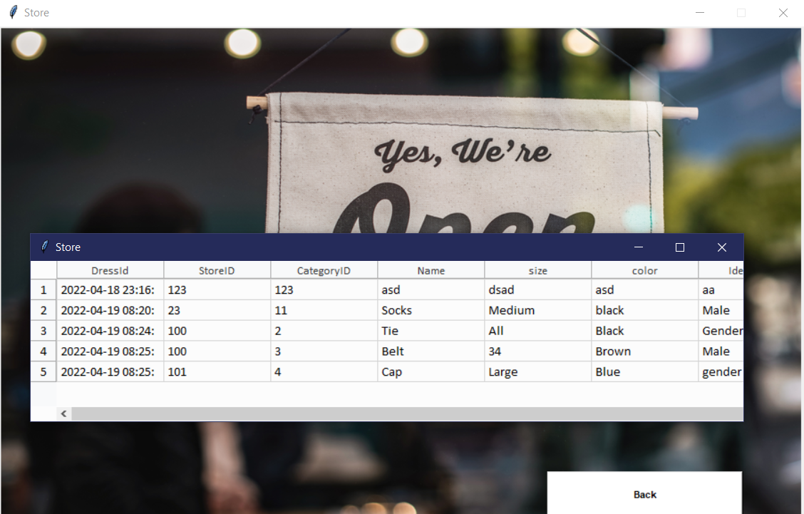
Upon login the user is presented with option to show the available
dresses to book or to show the booking
Show dress would invoke the dress database to show all available items

Slide 4
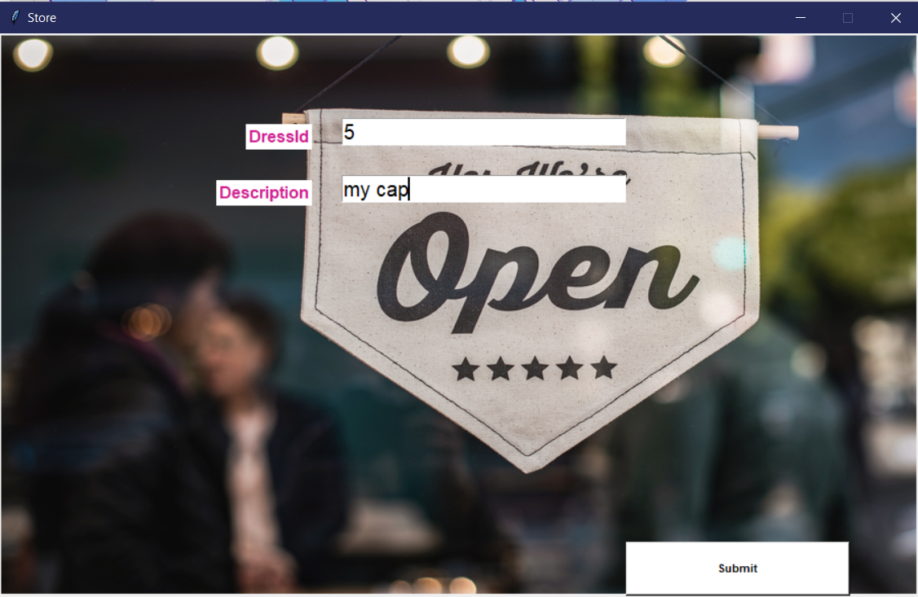
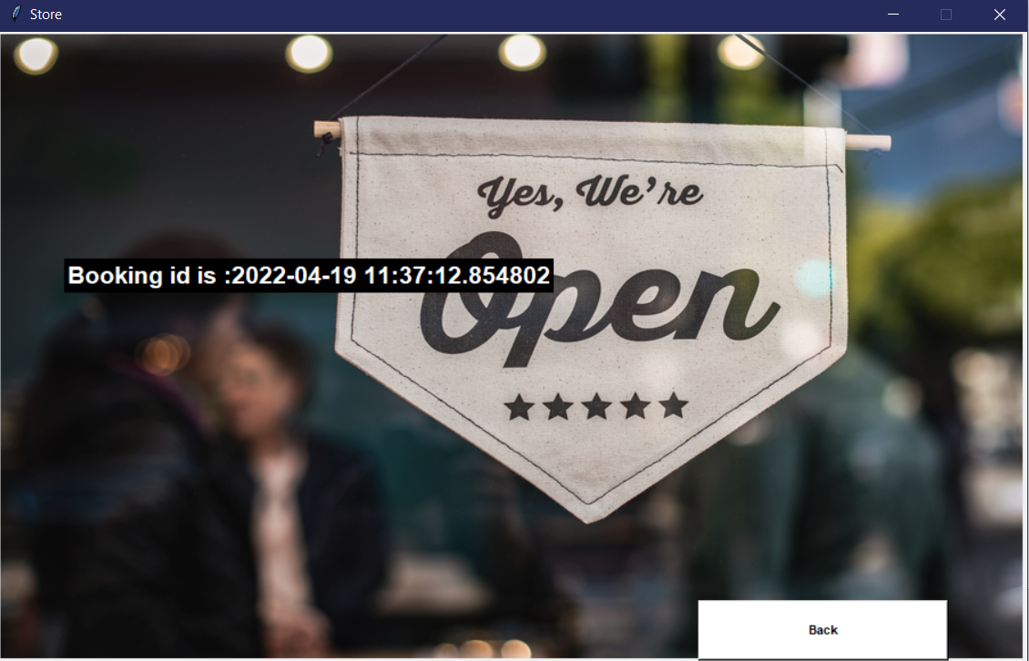
User is able to book he dress based on its dress id found in the show dress menu
Upon successful booking the user is presented with the booking reference

Slide 5
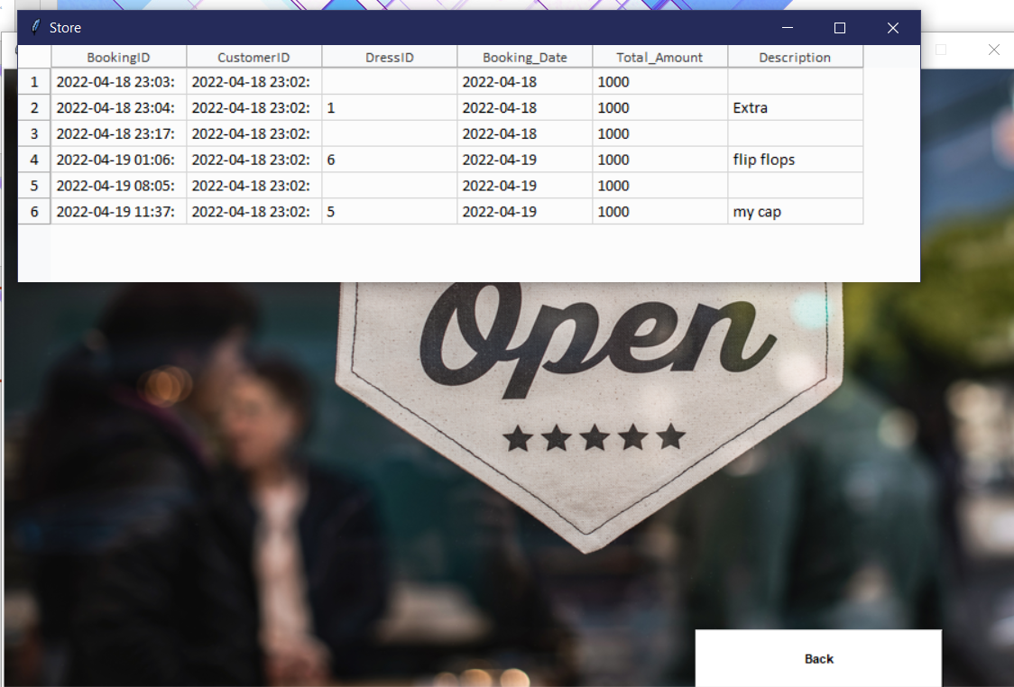
Once the booking is finished the new booking ID is displayed in the show booking

Slide 6
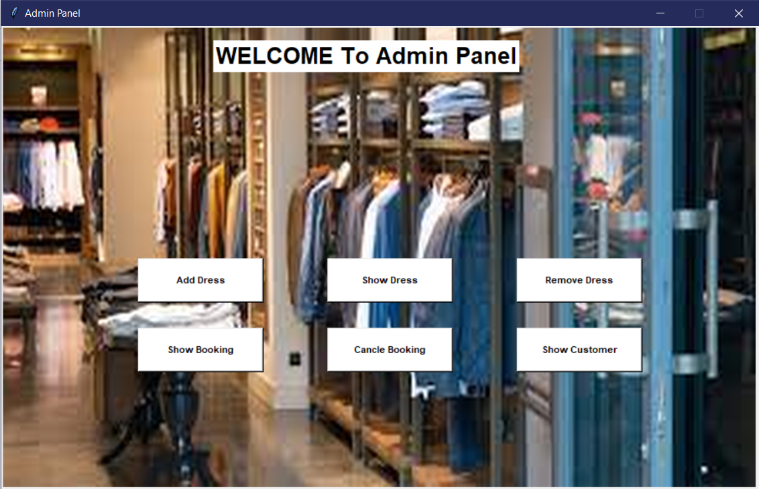
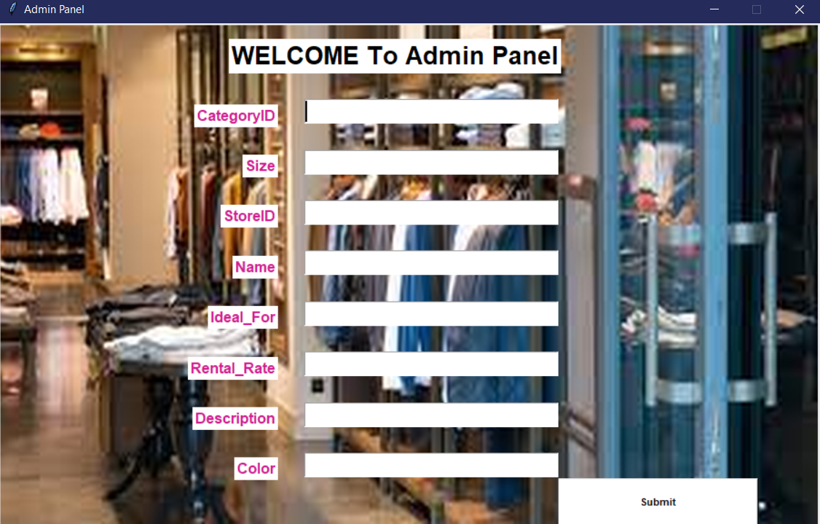
Admin page
Admin has super privileges to add or remove items or to cancel the booking based on booking ID
Admin can add the items with the following parameters to be added in the dress database

Slide 7
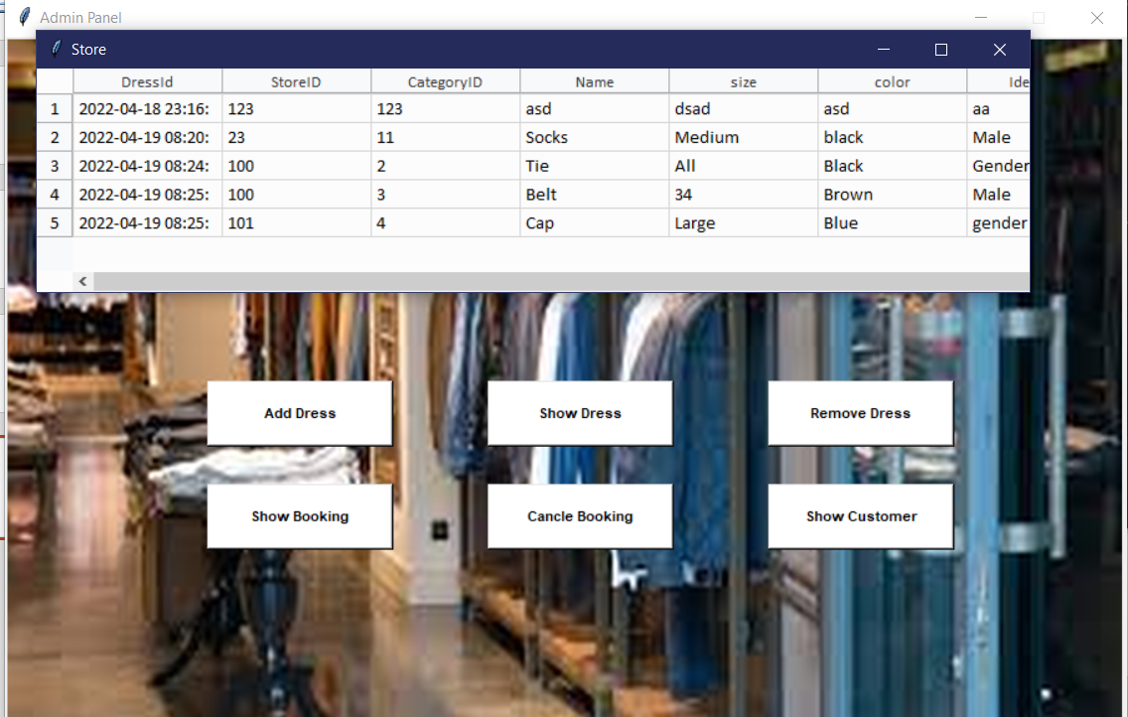
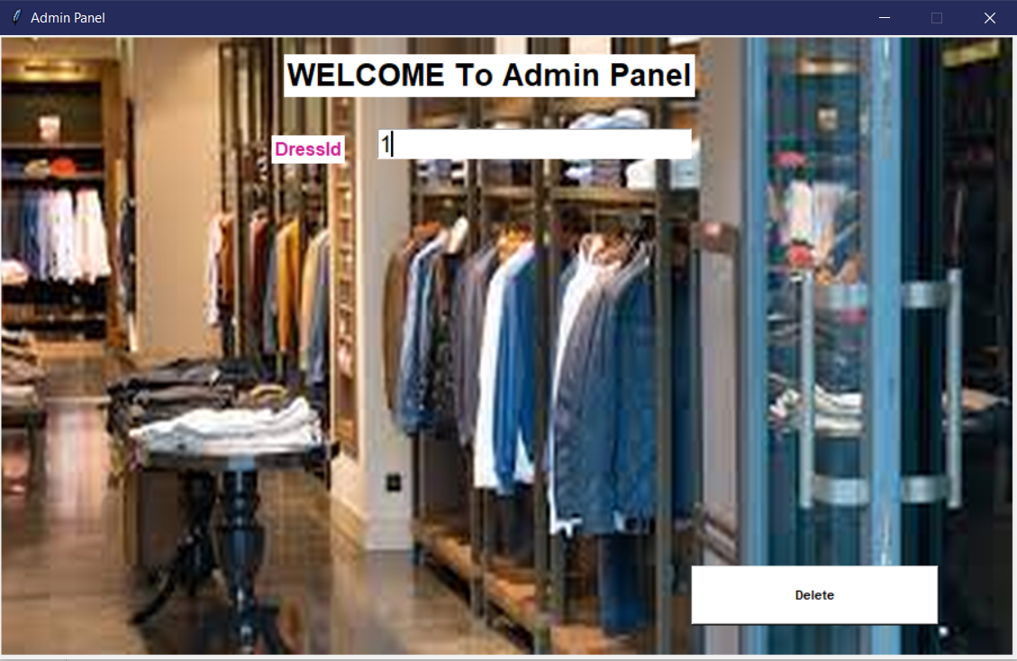
Admin can view the items available in the dress database
Admin can remove the items available in the dress database

Slide 8
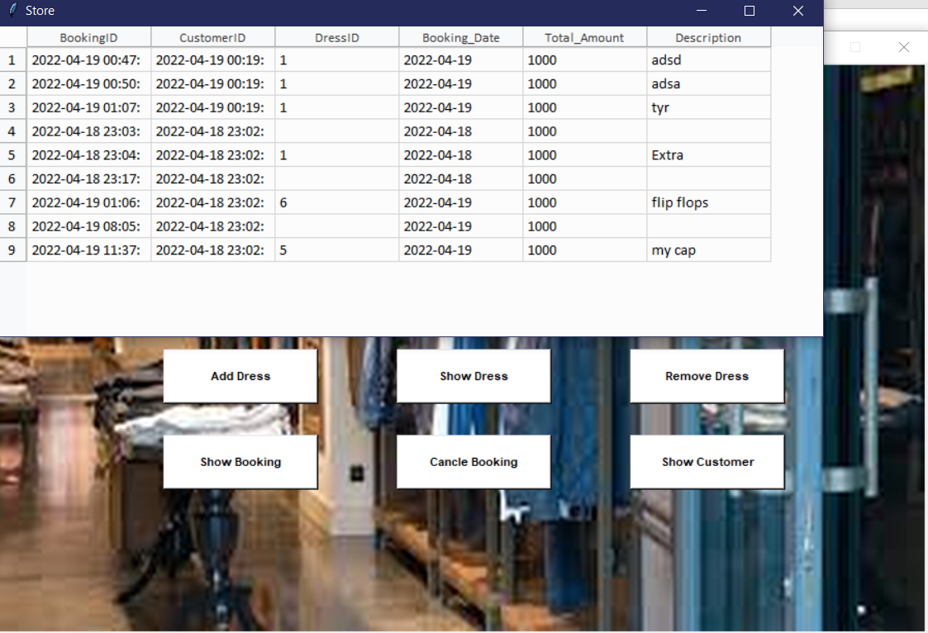
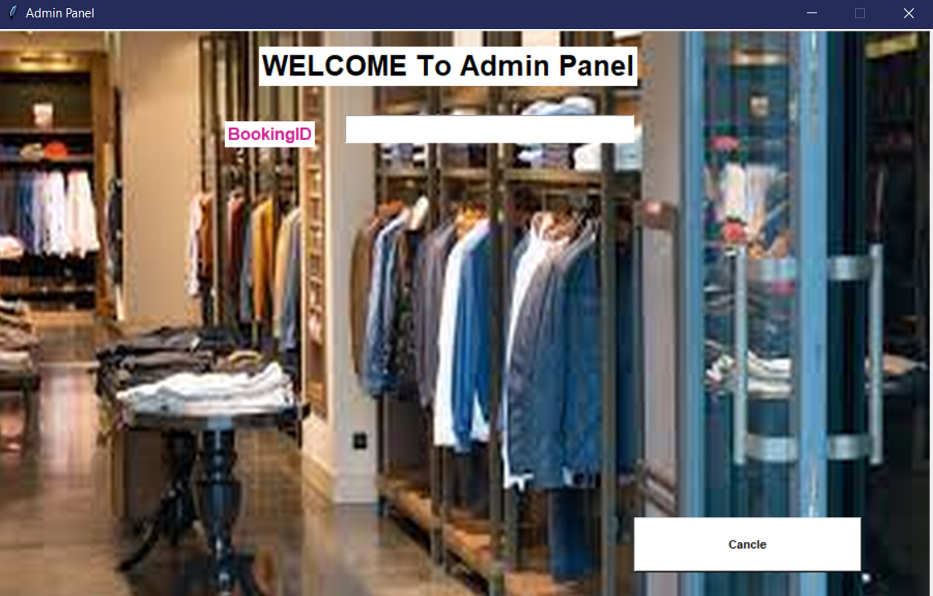
Admin can view the bookings available in the booking database
Admin can cancel the bookings in the booking database

Slide 9
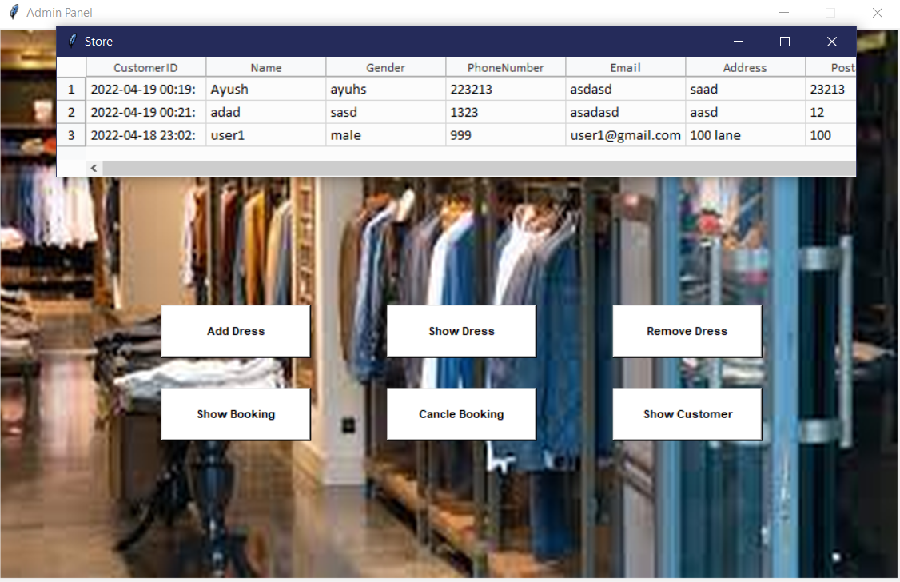
Admin can see all the users information in the user database

Slide 10
Thank you!

